Slide 1
Lesson objective
Title: Timely review
Aim:
Determine durations of events
Review classroom expectations
Plan:
Classroom expectations
Time jumps
Duration activity

Slide 2
What makes an effective learner?
Effective
Not Effective

Slide 3
Timed time questions
Mr. Davies drove 950km in 12 hours, how fast was he travelling on average?
What time is it 3hrs and 15min after 5:20pm?
Mr. Davies fished from 7:15am Monday till 6:30pm Tuesday. How long was he fishing?
Mr. Davies left his fishing spot at 6:30pm. He travelled 30 minutes to the camp site and cooked dinner. He then travelled 45 minutes to a new fishing spot. If he arrived at the new spot at 8:30pm, how long did it take him to cook/eat dinner?
79.17km/h
8:35pm
35 hrs and 15 minutes (zero fish caught)
45 minutes

Slide 4
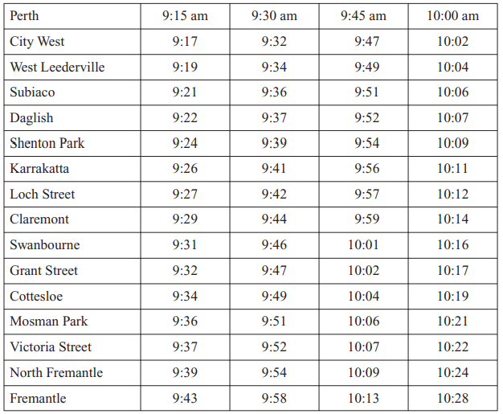
Time from Perth to Claremont
Subiaco to North Fremantle
If you need to be at Daglish station by 9:45am, which trains could you take from Perth?

Slide 5
Timetable review
Complete the “Planning simple journeys” activity sheet
Glue into book when finished

